Slide 1

FALL GATE PARENT MEETING 2022
Identification Categories
Dessa Keesee
GATE/SAS Coordinator dlk2473@lausd.net

Slide 2
MEETING AGENDA
Goal of Gifted/Talented Program
Truths and Myths about Giftedness
Characteristics of Gifted/Talented Learners
Needs of Gifted/Talented Learners
GATE Identification Categories
District Program Options
School Program
What is Differentiation?
What Can a Parent Do to Nurture Giftedness?

Slide 3
GIFTED/TALENTED
PROGRAMS GOAL
To identify gifted and talented students including those from diverse racial, socioeconomic, linguistic, and cultural backgrounds, and provide high-quality differentiated opportunities for learning that meet students’ unique abilities and talents.

Slide 4
DISPELLING THE
MYTHS
Myths About Gifted Learners:
MYTH: It is unfair to give special attention to gifted learners
RESEARCH SAYS: Fair does not mean the same – ALL students should receive educational opportunities that respond to their individual needs and learning styles
MYTH: Gifted students will do well on their own
RESEARCH SAYS: Gifted students may not reach their full potential if they are not given differentiated learning opportunities that meet their complex learning needs
MYTH: Gifted students should try to fit in with the mainstream
RESEARCH SAYS: Gifted students should not have to sacrifice academic excellence in order to fit in – it is the right of gifted students to stand out in their areas of strength
MYTH: Gifted students in special programs will develop social-emotional problems
RESEARCH SAYS: The reverse of this myth is more often true – social-emotional discontent may occur if students are not provided with stimulating learning experiences
Adapted from Stephens, K. “Promoting Gifted Education in Your Community”. Parenting for High Potential: 1998

Slide 5
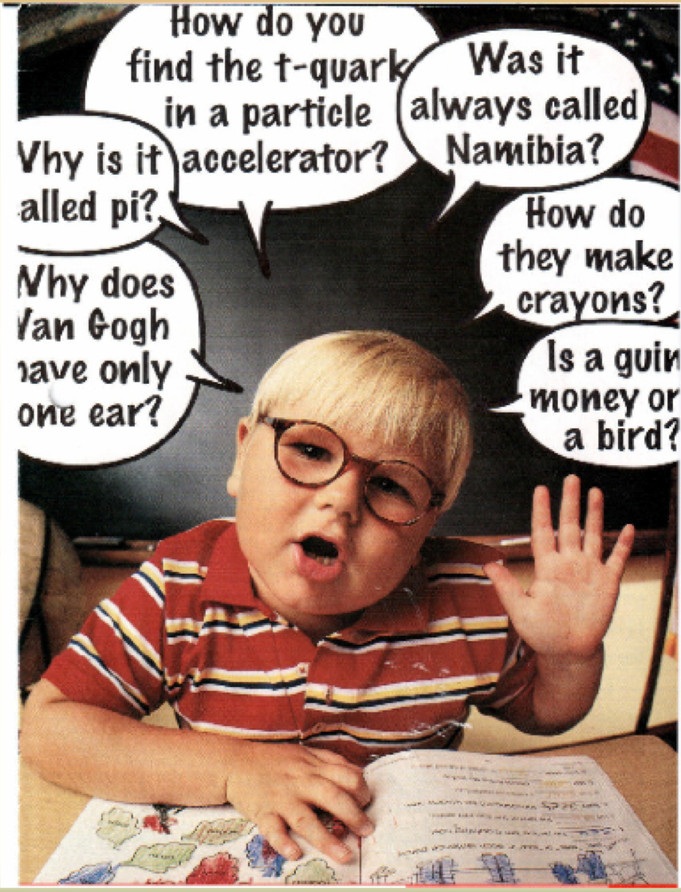
CHARACTERISTICS OF GIFTED LEARNERS
A Gifted Learner May Exhibit:
Early, rapid learning
Endless energy
Superior language ability; learns language quickly
Extensive knowledge and interest base
Exceptional memory
Keen, mature sense of humor
Complex/abstract thinking and great imagination
Superior reasoning/problem-solving ability
Long attention span when interested
Inappropriate acting out or apathy when disinterested
High level moral thinking; ability to detect injustice or inconsistency
Unrealistic self-expectations; perfectionistic and competitive
Frustrated with illogical or disorganized thinking
Impulsive, risk-taking behavior OR worried to take risks due to fear of failure
Overwhelming curiosity; questions everything and everyone (including authority)
Lack of desire to socialize with age-level peers; prefers the company of adults/older friends

Slide 6
WHAT GIFTED STUDENTS NEED
To deal with feelings of being different
To recognize and deal with stress
To learn how to be proud without being arrogant
To develop appropriate problem-solving skills
To be challenged with meaningful, differentiated learning
To have opportunities to interact with others of similar ability or interest
To recognize and accept their own abilities, interests, and limitations – and those of others
To be recognized as a gifted child, not treated as a small adult
Adapted from the 11th World Conference on Gifted and Talented Education, 1995

Slide 7
REFERRALS FOR IDENTIFICATION
If an administrator, teacher, parent, or child thinks a student is potentially gifted, they may provide this student’s name to the school site GATE screening committee.
The screening committee is responsible for determining if the child is ready for GATE referral and in what category. This screening process could include observing the student, looking through test score/report card records or portfolios, interviewing teachers, etc. Referrals are created in MiSiS for students being screened.
If the screening committee determines that the student is qualified and ready for evaluation, they will initiate the formal identification process. If not, they may discontinue screening.

Slide 8
CATEGORIES OF IDENTIFICATION
Intellectual Ability (Second semester kindergarten and above)
Students whose general intellectual development is markedly advanced in relation to their chronological peers; students are identified as gifted in Intellectual Ability by a Los Angeles Unified School District designated GATE psychologist.
High Achievement Ability (Fifth grade and above and second grade OLSAT-8 only)
Students who consistently function for two consecutive years at highly advanced levels in English-language arts and mathematics; evidenced by test scores (second graders may also be identified in High Achievement with the OLSAT-8)
Specific Academic Ability (Fifth grade and above)
Students who consistently function for three consecutive years at highly advanced levels in either English-language arts or mathematics (science or social science included in grades 9 – 12); evidenced by test scores

Slide 9
CATEGORIES OF IDENTIFICATION
Visual Arts Ability (Second grade and above)
Students who originate, perform, produce, or respond at exceptionally high levels in drawing and painting; evidenced by District demonstration/portfolio review
Performing Arts Ability (Second grade and above)
Students who originate, perform, produce, or respond at exceptionally high levels in either dance, voice, or drama; evidenced by District audition
Creative Ability (Second grade and above)
Students who characteristically perceive significant similarities or differences within the environment, challenge assumptions, and produce unique alternative solutions; evidenced by District portfolio or presentation review
Leadership Ability (Second grade and above)
Students who show confidence and knowledge; influence others effectively; have problem-solving and decision-making skills; express ideas in oral or written form clearly; show sense of purpose and direction; evidenced by District portfolio or presentation review

Slide 10

DID YOU KNOW?
Only the High Achievement and Specific Academic categories are determined by test scores and grades (these students are considered “slam dunks” because their scores automatically qualify them for identification).
All other categories require the professional expertise of the local school screening team and additional category-specific requirements (i.e. portfolio review for Visual Arts Ability, test by GATE psychologist for Intellectual, etc.).

Slide 11

SECOND GRADE TESTING FOR
HIGH ACHIEVEMENT CATEGORY
OLSAT-8 (Otis-Lennon School Ability Test, 8th Edition) is the Districtwide assessment given to all 2nd graders
OLSAT-8identifies students in the High Achievement category
The assessment is conducted each spring
The OLSAT-8 is a nationally standardized achievement test , that is norm-referenced, group administered and a measure of verbal and non-verbal school abilities
There is no highly gifted designation possible using the OLSAT because it is not an Intellectual assessment
Parent informational meetings are typically held in February and student scores are released in mid-May

Slide 12
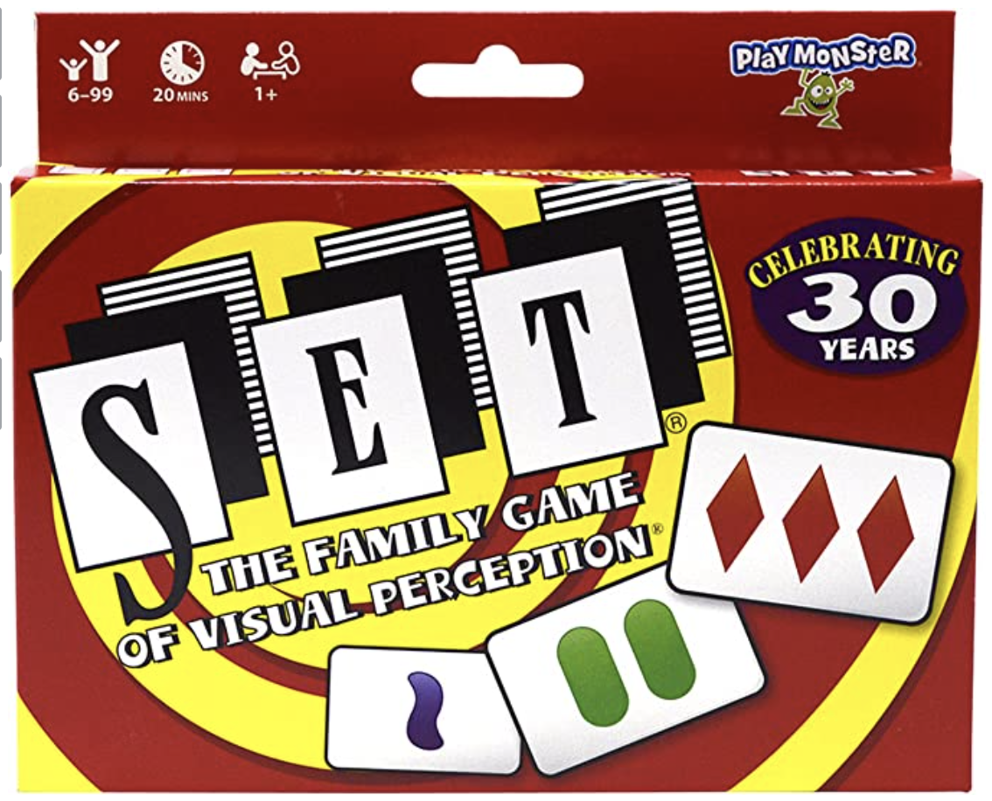
SECOND GRADE TESTING FOR
HIGH ACHIEVEMENT CATEGORY
Testing date is usually in March
Begin exposing students to the format of the test and the question types after Winter Break
District provided practice book
Set Game.
Notes:
https://www.setgame.com/set/puzzle

Slide 13
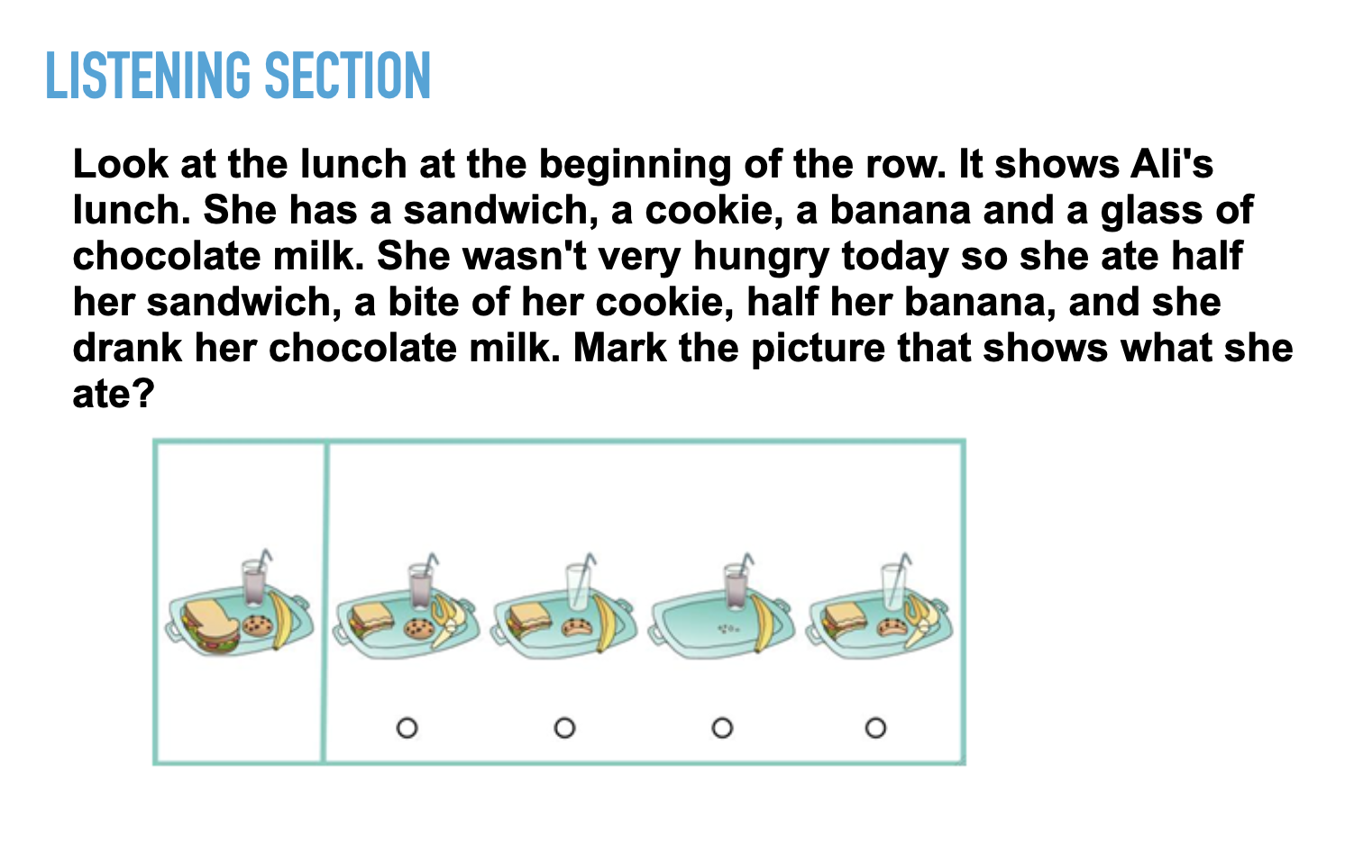
OLSAT
Listening Section
Notes:
https://www.setgame.com/set/puzzle

Slide 14
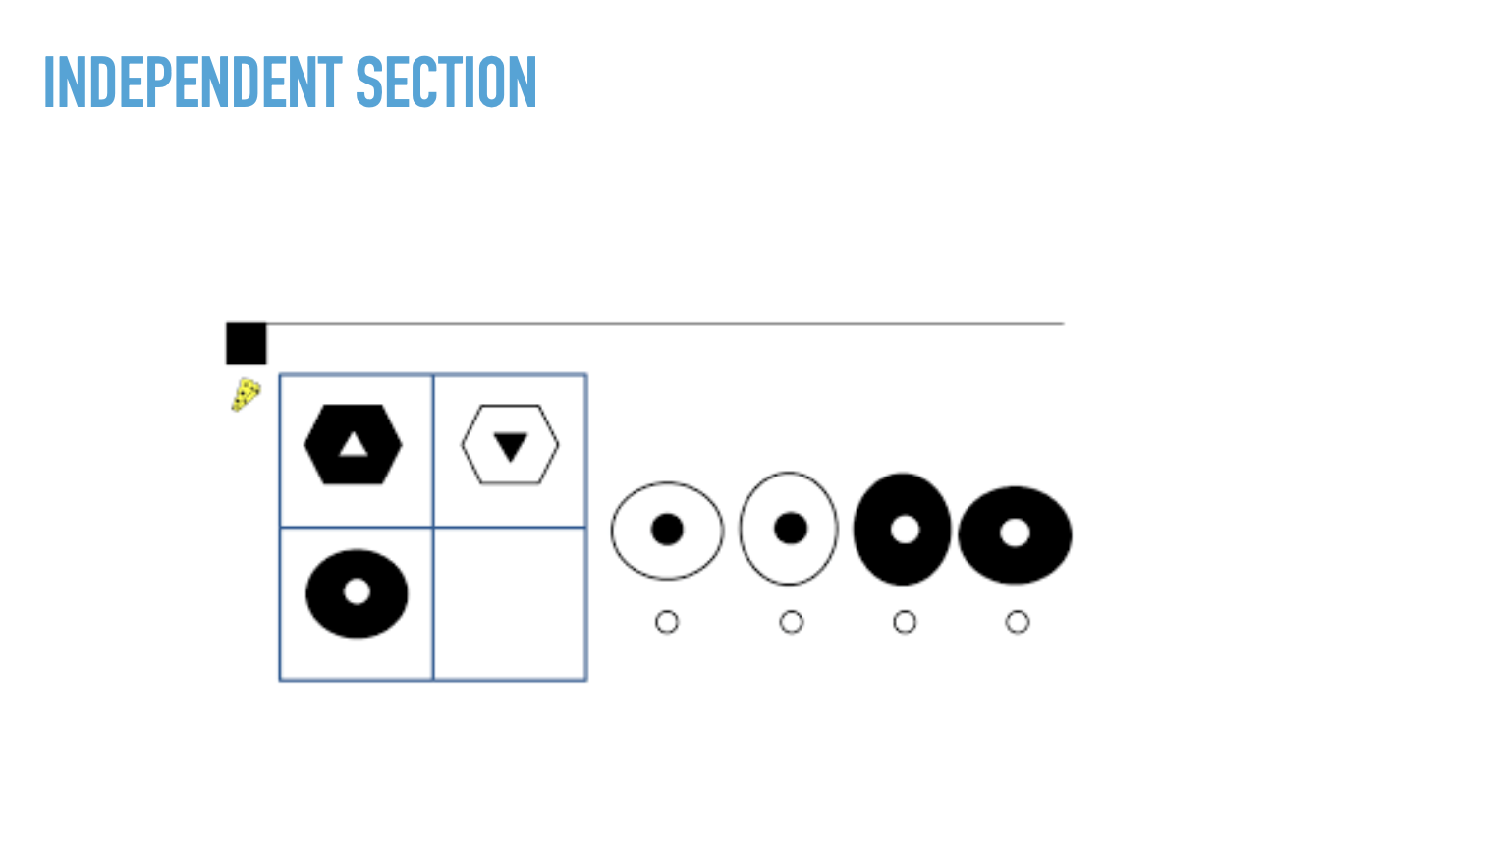
OLSAT
Independent Section
Notes:
https://www.setgame.com/set/puzzle

Slide 15
HIGHLY GIFTED DESIGNATION:
INTELLECTUAL CATEGORY
The term “highly gifted” refers to students who receive a percentile rank of 99.9 on the Intellectual assessment given by a District GATE Psychologist. No other identification category has a highly gifted designation.
Highly gifted students may apply to Highly Gifted Magnets.
Students who receive a percentile rank of 99.5 - 99.8 on the intellectual assessment are considered “highly gifted applicable” and may apply to Highly Gifted Magnets if space is available.
There is no special test for identification as highly gifted.

Slide 16

Creative Ability Category
Students who consistently engage in divergent thinking or conceptualize in abstract terms at high levels; have the ability to think up and design new inventions, solve problems in new ways, develop an idea based on an original, novel, or unconventional approach.

Slide 17
Creative Ability Characteristics
• Display fluency and generate a number of ideas
• Show flexibility (thinking patterns; products)
• Elaborate, add to, embellish, or build off of an idea or product
• Show originality
• Conceptualize difficult ideas
• Be willing to try new things or take risks; spontaneous; intuitive
• Demonstrate imagination and inventiveness
• Express curiosity; humor
• Perceive significant similarities or differences within the environment
• Challenge assumptions
• Produce alternative solutions
• Has persistency

Slide 18
Creative Ability Evaluation
2nd grade and above
Portfolio of 3-5 Pieces of Student Work (Artifacts)
* Exemplary or show potential for creativity
* NOT work meeting grade level
* Products, projects, activities, lessons, tasks, etc.
* Multimedia format
* Links (Blogs, websites,YouTube, FlipGrid, Google Slides, etc.)
* Videos
* Photos
* Word Documents, PDFs, PPTs, etc.

Slide 19
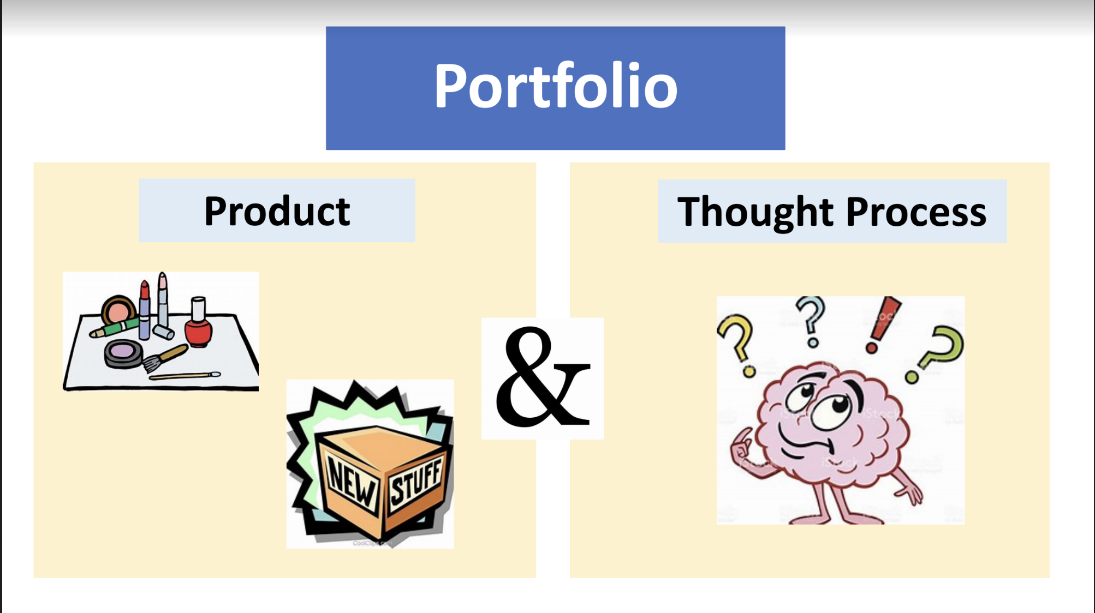

Slide 20

Leadership Ability Category
Students who show confidence and knowledge; influence others effectively; have problem-solving and decision making skills; express ideas in oral or written form clearly; show sense of purpose and direction.

Slide 21
Leadership Ability Characteristics
• Possesses the ability to organize, inspire, and promote activities
• Motivates peers and even adults
• Exhibits unique skills: associating, questioning, observing, experimenting, and
networking
• Can coordinate the work of several individuals
• Is looked at by others for decisions
• Can establish the mood of a group
• Exercises authority
• Gives direction
• Relates and interacts with others

Slide 22
LeadershipEvaluation
2nd grade and above
Portfolio of 3-5 Pieces of Student Work (Artifacts)
* Exemplary or show potential for leadership
* NOT work meeting grade level
* Products, projects, activities, lessons, tasks, etc.
* Multimedia format
* Links (Blogs, websites,YouTube, FlipGrid, Google Slides, etc.)
* Videos
* Photos
* Word Documents, PDFs, PPTs, etc.

Slide 23
What topic is the student interested in?
Poverty
Recycling
Environment
Immigration

Slide 24
What activities could students initiate?
Clubs/fundraisers/fairs
Challenges/contests
Volunteer at an organization/charity awareness campaign
Assemblies/ambassador programs/mentorships

Slide 25
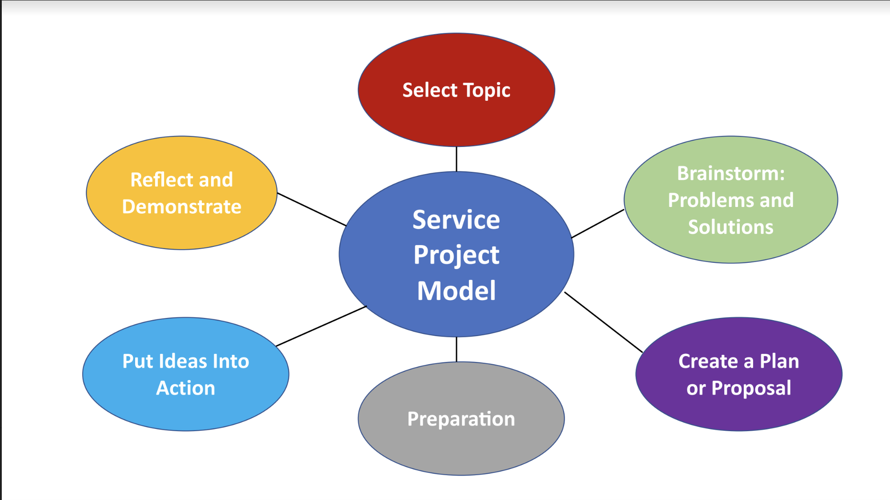

Slide 26
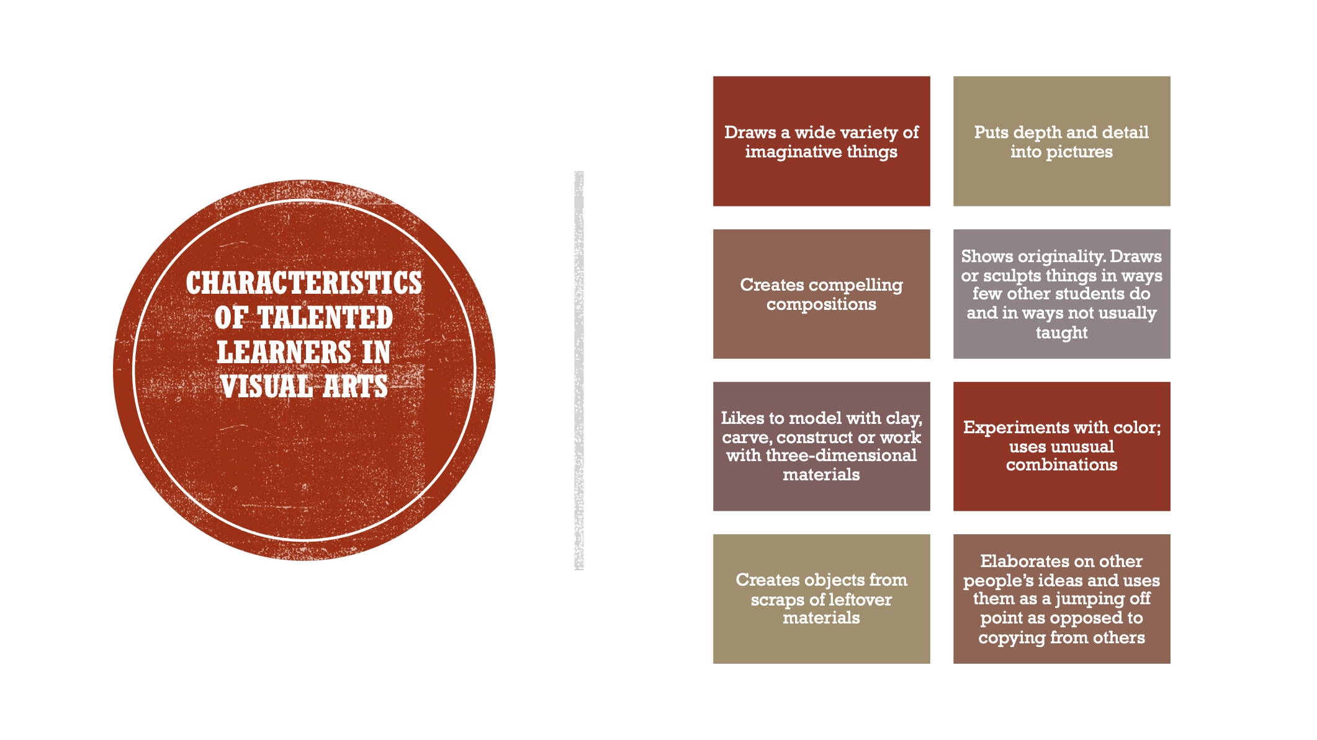

Slide 27
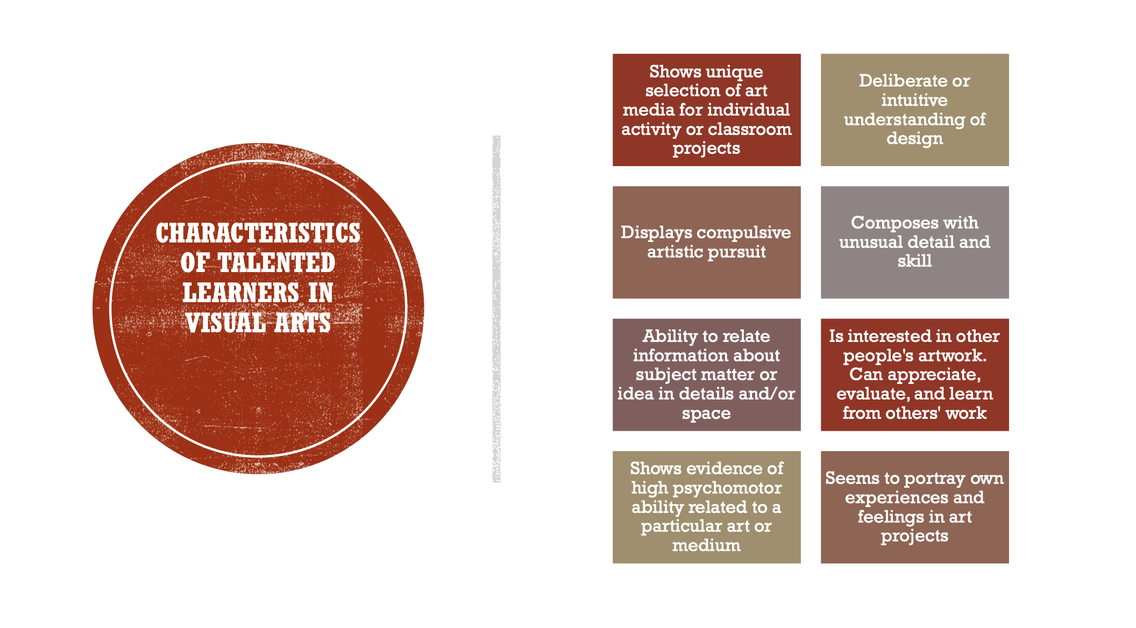

Slide 28
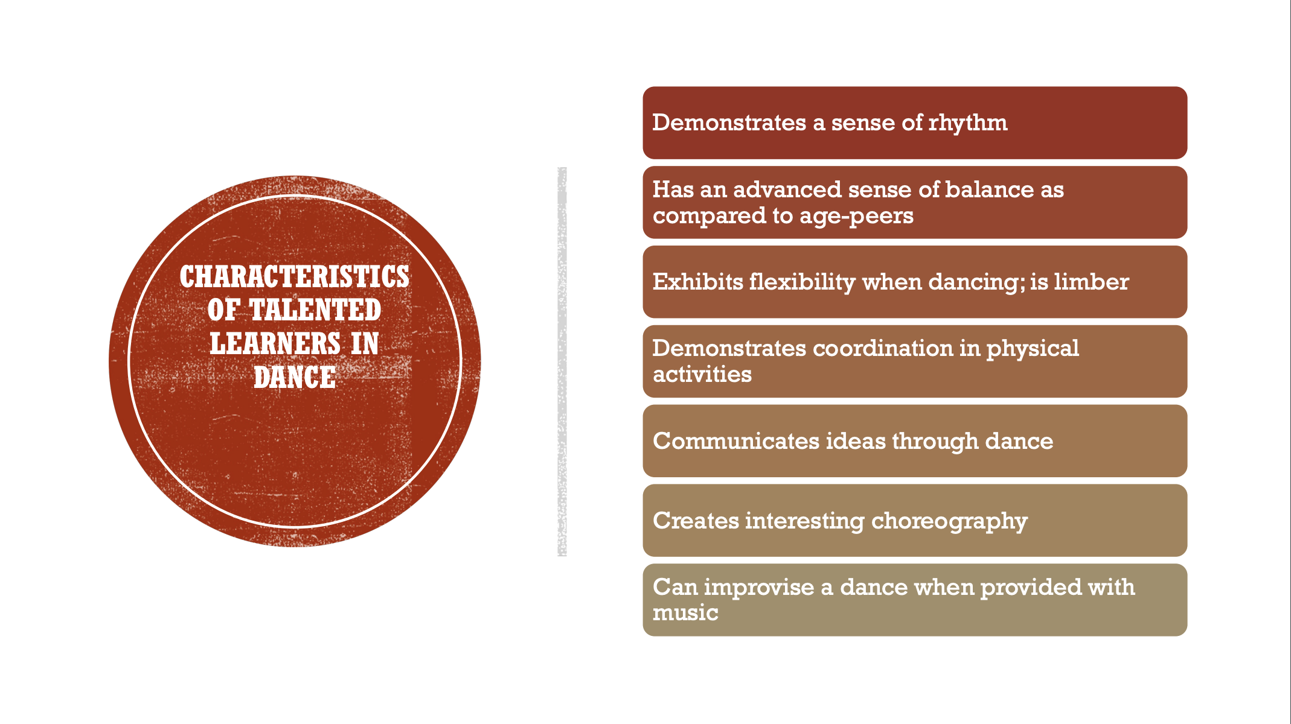

Slide 29
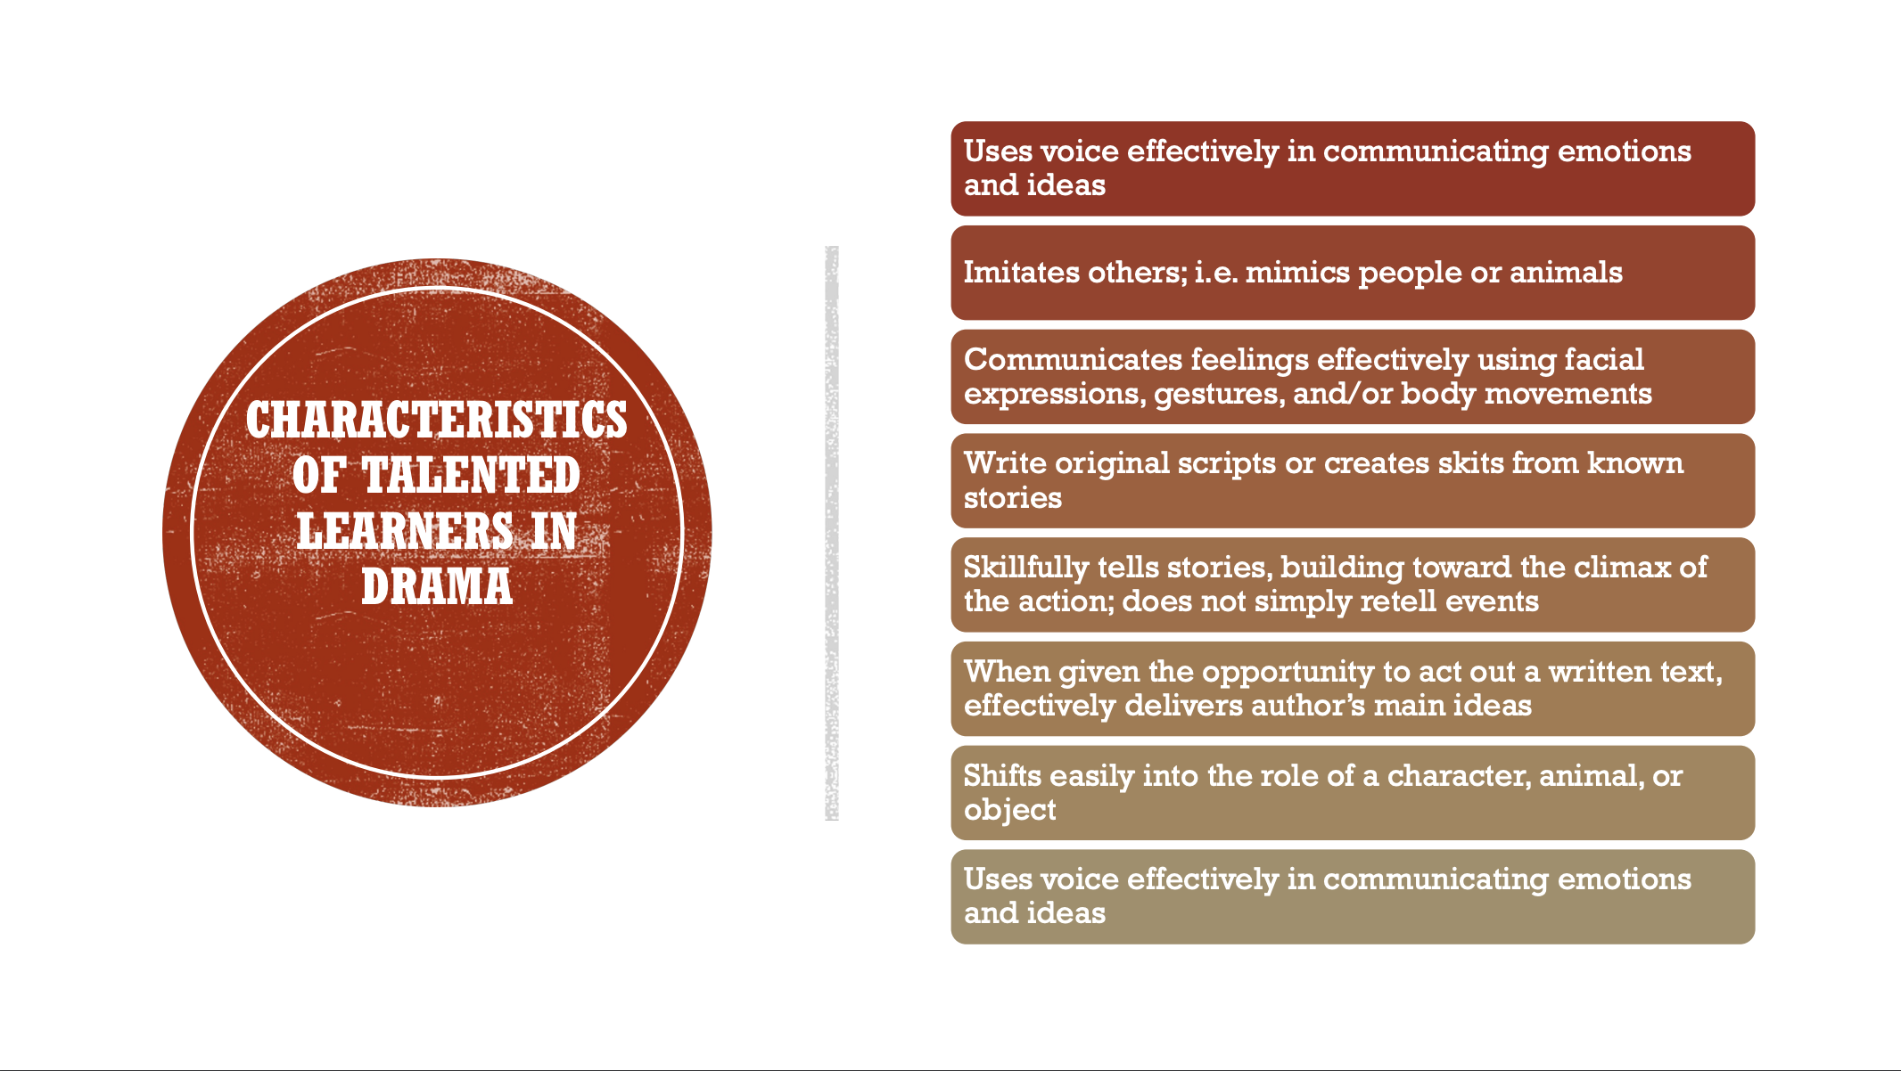

Slide 30
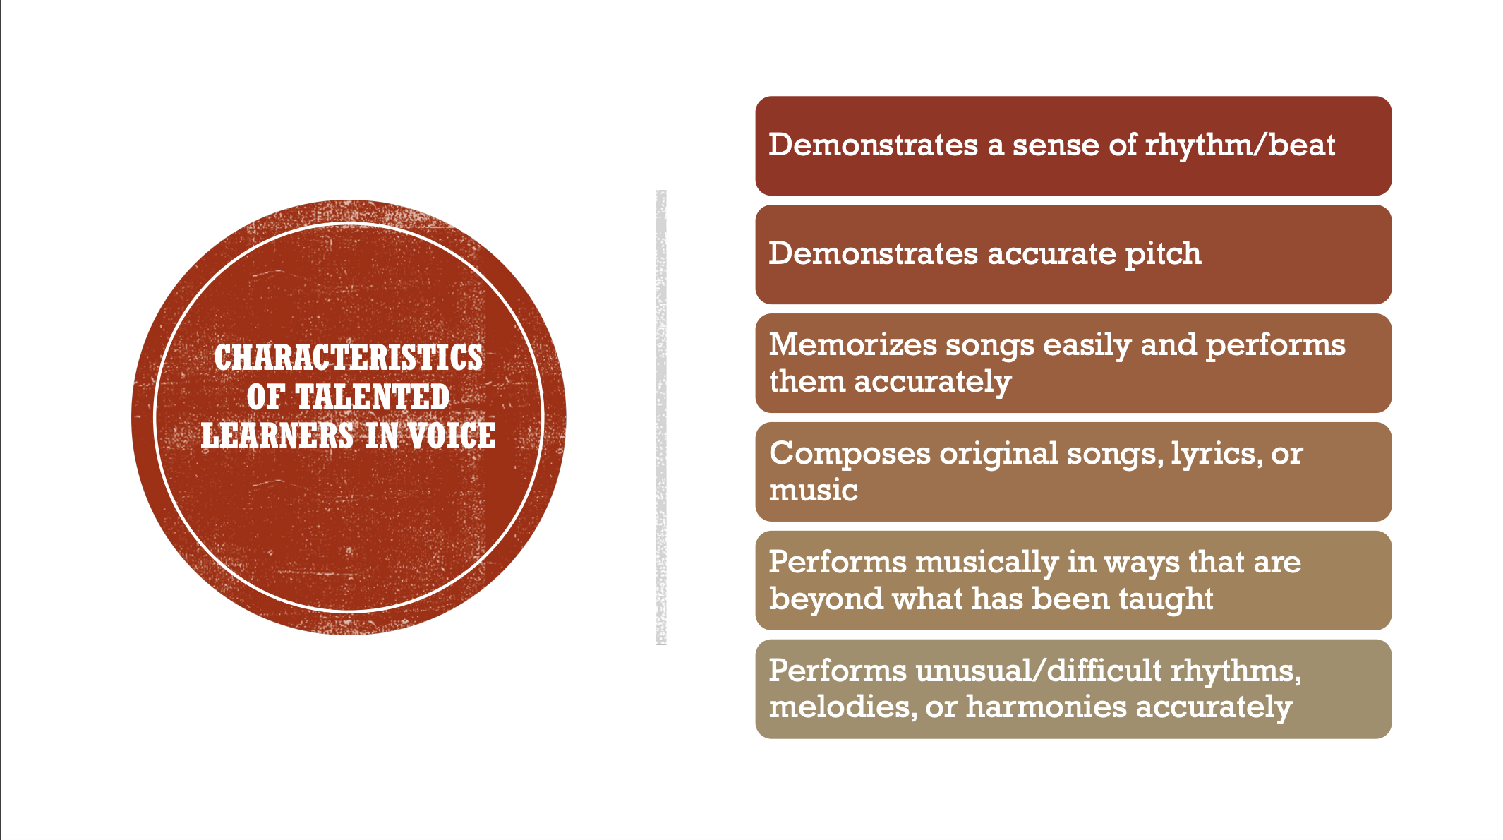

Slide 31
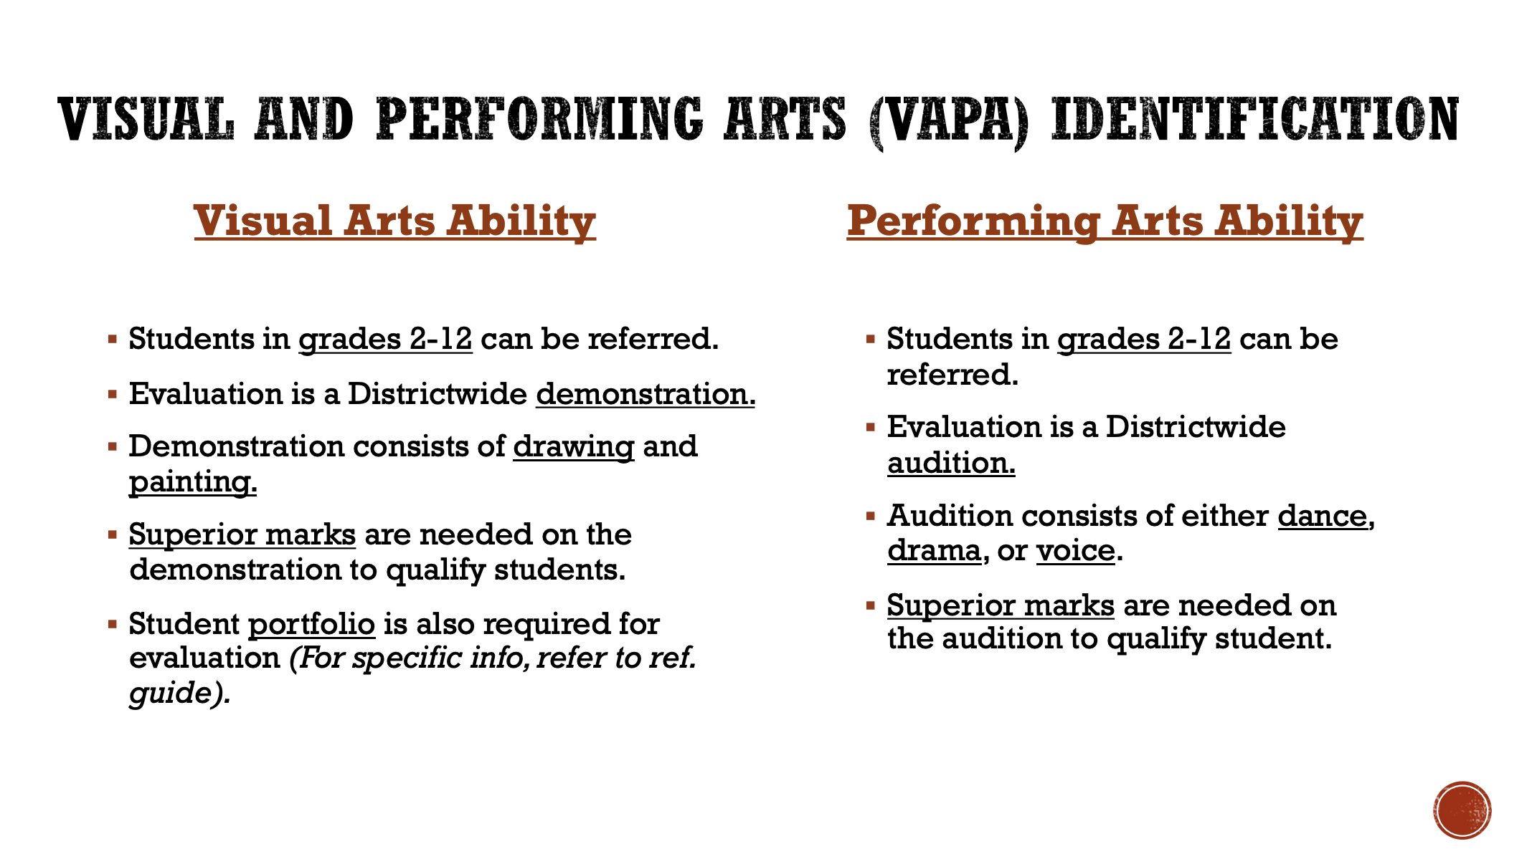

Slide 32
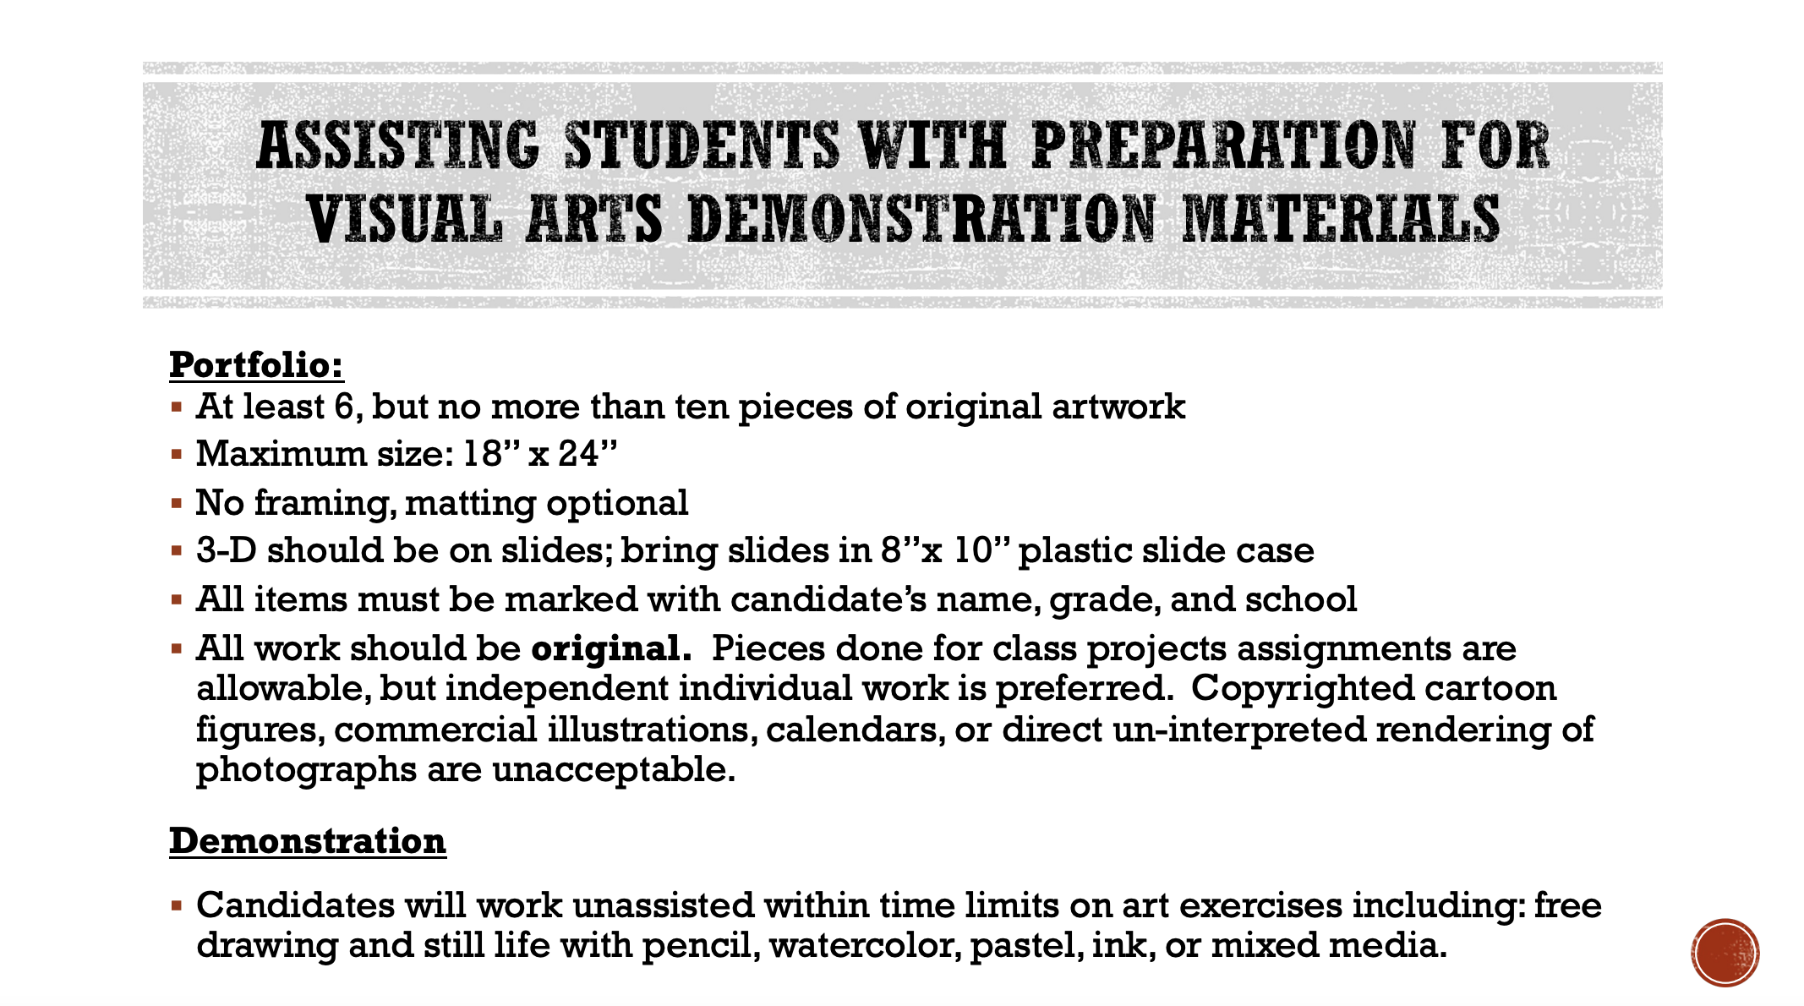

Slide 33
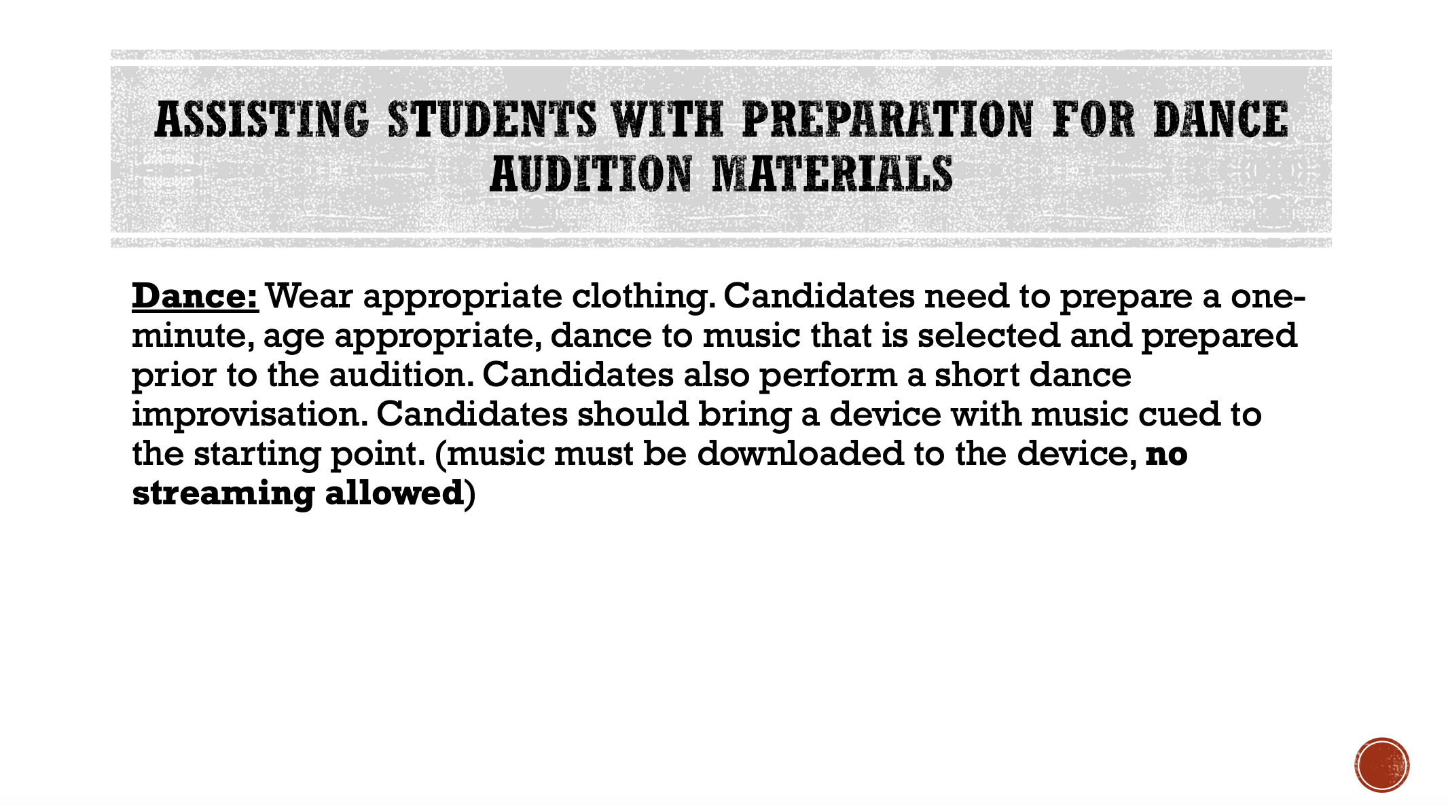

Slide 34
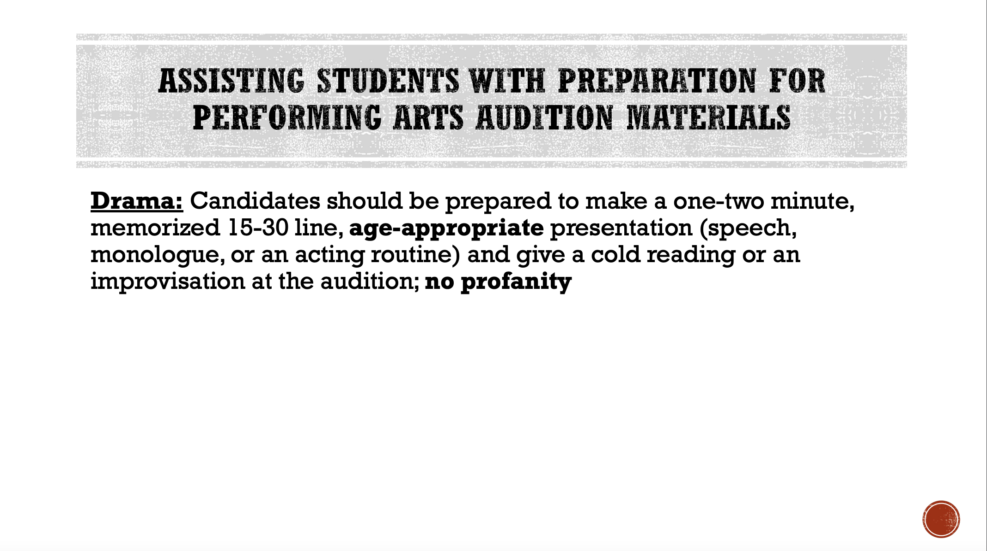

Slide 35
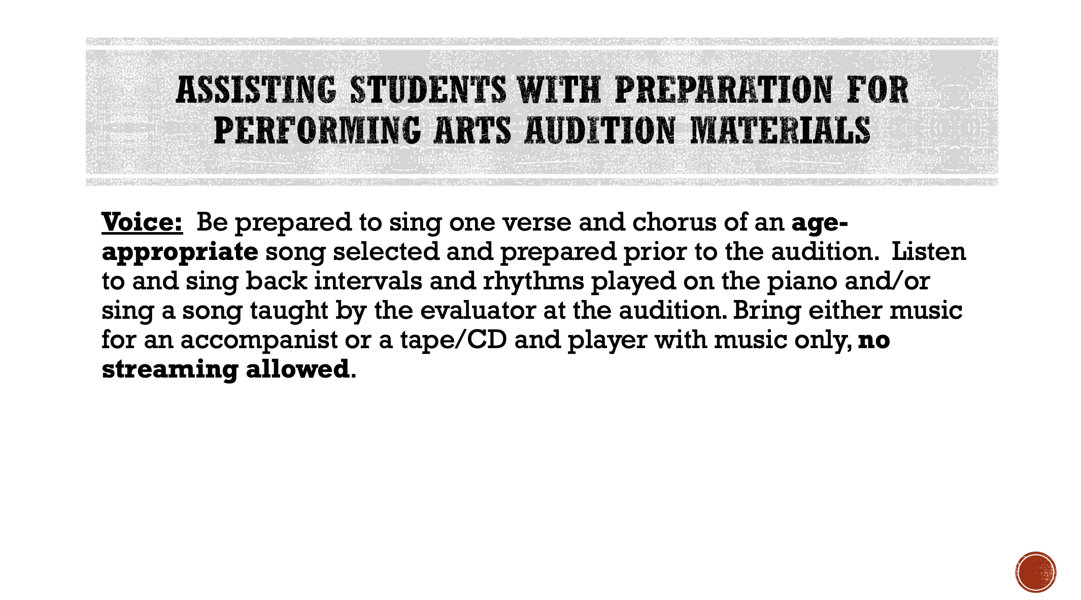

Slide 36


Slide 37
IDENTIFICATION… AND BEYOND!
Gifted identification is not the final goal of this program.
Identification is the tool that allows teachers and schools to make instructional and programming decisions to best meet the academic and social-emotional needs of students.
The identification process has little value without appropriate clustering and differentiated instruction to follow.

Slide 38

GATE PROGRAM OPTIONS
Cluster model in resident schools
**Schools for Advanced Studies (SAS)**
Gifted Magnets
Highly Gifted Magnets
Conservatory of Fine Arts
Honors and Advanced Placement (AP) courses (middle and senior high school)

Slide 39
SCHOOL GATE/SAS PROGRAM
Creative Thinking
Focus upon important details.
Repeat, adapt, improve, modify activities; ideas, concepts, and products.
Demonstrate creativity unique to the individual when doing an assignment.

Slide 40
SCHOOL GATE/SAS PROGRAM
Critical Thinking
Investigates problems, issues, facts, and concepts.
Determine validity of various sources from print, media, and technology.
Interpret information.

Slide 41

NO MATTER WHAT PROGRAM, IT’S ALL ABOUT DIFFERENTIATION:
HOW IS THE CORE CURRICULUM MODIFIED TO MEET THE NEEDS OF GIFTED LEARNERS?
Accelerated pacing
Advanced content
Depth, complexity, and novelty
Above grade-level resources
Tiered assignments
Learning/interest centers
Independent study
Flexible grouping
High level questioning
“Think Like a Disciplinarian”

Slide 42
WHAT CAN A PARENT DO TO NURTURE GIFTEDNESS?
Read daily to/with your child; ask questions that require high-level thinking
Take your child to get his/her own public library card; encourage self-selection of books in a variety of genres and content areas
For younger children, provide play materials that can be used in creative ways such as blocks, art supplies, or recycled materials
Take family trips to places of interest such as museums, aquariums, gardens, historical sites, and performances
Monitor and limit TV viewing and video game playing; encourage activities that require critical thinking and problem solving
Provide some safe opportunities for ambiguity/frustration –struggling intellectually is an important part of learning
Practice research skills in areas of interest; model appropriate use of reference books and the internet to find answers to questions
Encourage your child’s empathy and social responsibility, not just academic achievement
Adapted from Mountford, S. “What Can a Parent Do?” California Association for the Gifted Parent Handbook.

Slide 43
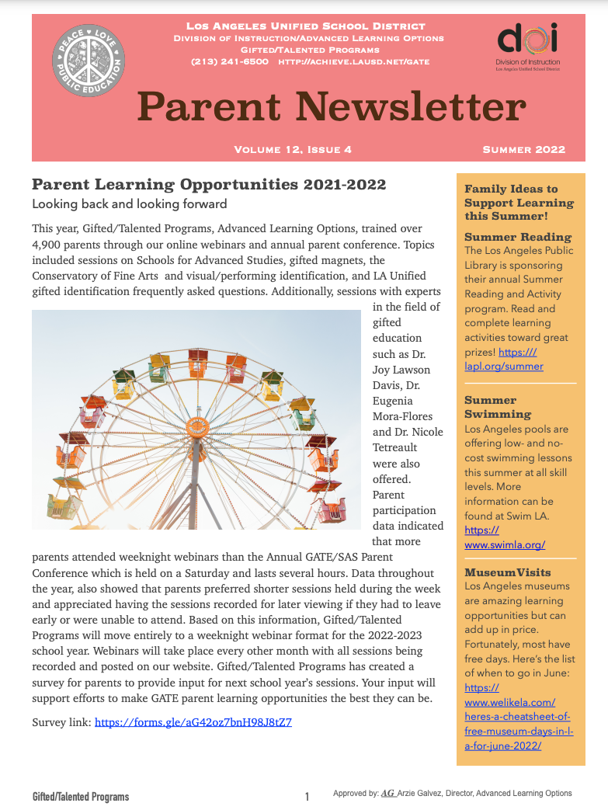
BE SURE TO READ THE
GATE PARENT NEWSLETTER!
Published quarterly
Current and past issues are available in English and Spanish on the GATE website
Go to achieve.lausd.net/gate and click on “Parents”
Click on “Parent Newsletters”

Slide 44
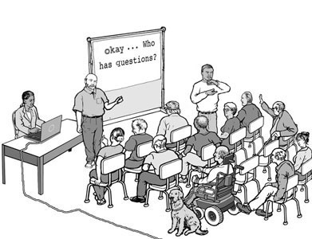
ADDITIONAL DISTRICTWIDE GATE PARENT MEETINGS
The annual GATE/SAS Parent Conference and February Parent Meeting have been replaced by bi-monthly webinars.

Slide 45




Q & A
Questions or comments?
For more information, visit http://achieve.lausd.net/gate or email GATE@lausd.net
Thank you attending!
Together, we make a difference.

